Slide 1
Score and Winner Prediction Using NBA Analytics
Asish Nelapati
Sardorbek Mirzaliev
Matt McMahon
Deep Learning (Spring I, 2025)
Chengfei Wang

Slide 2
Imagine Knowing The Result Of An NBA Game Before It Even Happened

Slide 3
Context and Introduction
The NBA is the greatest professional basketball league in the world
30 teams, 1,230 games per season and $11 Billion in Annual Revenue
The number of recorded statistics (points, assists, rebounds, steals, etc.) make it an optimal place to for AI prediction
Teams have transformed the way they played based on advanced sports statistics.
The rise of fantasy sports and sports betting have led many to wonder about the prediction capabilities of AI on sports games

Slide 4
Problem and Challenges
Most prediction models rely on what are known as box-statistics
Points, steals, assists, etc.
The NBA real-world environment features more complex factors
Game-specific variables (back-to-back games, travel fatigue, player injuries)
Advanced analytics (i.e., player plus-minus)
The game is more dynamic than the static box-statistics would leave you to believe.
AI handles this problem.

Slide 5
Related solutions / State of Art
"Predictive Analysis of NBA Game Outcomes through Machine Learning" (Wang, 2023)
Compared Logistic Regression, SVM, Deep Neural Networks (DNN), and Random Forest
Found DNN and Random Forest Models produced the highest accuracy
"SMART SPORTS PREDICTIONS VIA HYBRID SIMULATION: NBA CASE STUDY" (Erazo, 2023)
Treated NBA teams as "agents" and simulated team strategies
Considered player fatigue, rest schedules and coaching adjustments
"NBA Game Prediction Using Machine Learning Algorithm" (Patrot et al., 2023)
Used Linear Regression, Decision Trees and SVM
92% accuracy utilizing team-based factors (i.e., Offensive Rating, Defensive Rating, Assist Ratio, Turnover Ratio)
"Integration of Machine Learning XGBoost and SHAP Models for NBA Prediction" (Ouyang et al., 2024)
"Dynamic Outcome Prediction of an NBA Match" (Kandhway, 2023)
Built a real-time model that updates predictions quarter-by-quarter.

Slide 6
Overview of Solution / Contributions
The goal of this project is to develop a model that outperforms traditional basic prediction models. This is done using historical data, as well as team and player data.
The aim is to be able to accurately select:
NBA Game Winners (classification: 0 = loss, 1 = win)
Final Game Scores (regression)
Contributions:
Data-Driven Feature Engineering
Player and team stats: Assists, Rebounds, Shooting %
Advanced metrics: Win Shares, Player Efficiency Ratings
Contextual factors: Back-to-back games, home-court advantage
Data Preprocessing & Normalization
Clean + Standardized NBA game datasets
Normalized numeric features

Slide 7
Data Collecting
NBA Game Data was collected from Kaggle, which included:
All NBA games from the 2004 season to December 2020
Detailed player and team statistics from the 2004 season to December 2020
The NBA Game Data from Kaggle is sourced from NBA.com

Slide 8
Data Preprocessing
Dataset: Sourced from a public NBA historical dataset
games.csv → Game-by-game stats & outcomes (e.g., scores, shooting percentages, assists, rebounds)
teams.csv → Team metadata (e.g., team names, locations, conferences)
26,000+ games analyzed across multiple NBA seasons.
Data Cleaning
Dropped Unnecessary Columns (i.e., GAME_ID)
Date Handling (Turned GAME_DATE_EST into numerical format)
Missing Data (Filled missing data values using the median of each feature)
Feature Engineering
Data Normalization
Train-Test Split
Features (X): Game statistics & engineered metrics.
Target (y): HOME_TEAM_WINS (binary: 1 = win, 0 = loss).

Slide 9
Methodology: Machine Learning Models
Explored multiple ML models to establish baselines
Used Logistic Regression, KNN, SVM, Decision Tree, Gradient Boosting, Random Forest, and XGBoost
Applied hyperparameter tuning to optimize performance
Implemented a Voting Classifier for ensemble learning
Combined Random Forest, Gradient Boosting, XGBoost, and others
Achieved 95.18% accuracy, outperforming individual models
Feature engineering improved model performance
Created new metrics (Win Shares, Efficiency Ratings, Assist/Rebound Differentials)
Encoded categorical variables and normalized continuous features

Slide 10
Methodology: Deep Learning Models
Built a fully connected neural network for prediction
Architecture: Two hidden layers (128 → 64 neurons) with ReLU activation
Used Dropout layers (30%) to prevent overfitting
Trained with Adam optimizer & Binary Cross-Entropy loss
Ran 50 epochs, batch size of 32
Monitored validation accuracy to detect overfitting
Deep learning underperformed compared to ML models
Achieved 58.7% accuracy, highlighting challenges with structured data
Potential for improvement with more data and advanced architectures

Slide 11
Model selection and parameters
Baseline & Ensemble Models:
Tested Logistic Regression, KNN, SVM, Decision Tree, Gradient Boosting, Random Forest, and XGBoost
Voting Classifier (Ensemble Model) combined multiple models for best accuracy
Hyperparameter Tuning for Random Forest:
Grid Search optimized tree depth, number of estimators, and split criteria
Final ML Model Performance:
Voting Classifier achieved 95.18% accuracy, outperforming individual models

Slide 12
Model selection and parameters
Neural Network Architecture:
Input Layer: 23 features
Hidden Layers: 128 → 64 neurons (ReLU activation)
Dropout layers (30%) to prevent overfitting
Output Layer: 1 neuron (Sigmoid activation for classification)
Training & Optimization:
Adam optimizer & Binary Crossentropy loss
50 epochs, batch size of 32
Final Performance:
Accuracy: 58.7%, lower than ML models, but highlights potential

Slide 13
Network Training – Validation - Testing
Deep Learning Model:
Architecture: 2 hidden layers (128 → 64 neurons) with ReLU activation
Optimization: Adam optimizer, Binary Crossentropy loss for classification
Regularization: Dropout (30%) in each hidden layer to prevent overfitting
Training Configuration:
Epochs: 50
Batch Size: 32
Feature Normalization: Min-Max Scaling applied
Used a validation set during training to monitor performance
Ensured the model didn’t memorize training data
Dropout layers helped generalization by preventing over-reliance on specific neurons
Did not apply early stopping, but observed validation loss to detect overfitting trends

Slide 14
Evaluations – Performance – comparing
Voting Classifier (Ensemble Model) – Best Performer
Combined Logistic Regression, Decision Tree, Gradient Boosting, Random Forest, and XGBoost
Achieved 94-95% accuracy through cross-validation
Cross-validation confirmed ensemble stability (~94-95% mean accuracy)
Confusion Matrix Analysis
Few misclassifications; strong correlation between home-team advantage and game stats
Key features: Assists, rebounds, efficiency ratings played significant roles in game predictions

Slide 15
Outcomes/Findings
Ensemble Learning Outperformed Deep Learning
Voting Classifier (Ensemble Model) achieved 94-95% accuracy, outperforming individual models
Deep Learning model struggled (58-60% accuracy) with structured tabular data
Feature Importance Analysis Identified Key Factors
Assists, rebounds, and efficiency ratings were the strongest predictors of game outcomes
Home-team advantage & shooting percentages played significant roles in predicting wins

Slide 16
Lessons learned and Perspectives
Feature Engineering Is Critical for Performance
Game stats alone are not enough—contextual features (e.g., back-to-back games, efficiency ratings) significantly impact predictions
Ensemble models leverage feature interactions more effectively than deep learning on structured data
Deep Learning Needs More Optimization for Structured Data
Traditional ML (e.g., Random Forest, XGBoost) outperformed deep learning (58-60% accuracy)
Neural networks may require more specialized architectures or additional feature engineering
Incorporate Real-Time Game Updates
Implement live in-game updates to adjust predictions dynamically

Slide 17
Bibliographical References
NBA Game Dataset: Kaggle - Nathan Lauga
Basketball-Reference Data: Basketball-Reference
NBA Game Prediction with Ensemble Voting Model
IEEE Xplore
Dynamic Outcome Prediction of an NBA Match
Explainable AI Techniques for NBA Game Prediction
NBA Game Prediction Using Machine Learning Algorithms
Predictive Analysis of NBA Game Outcomes Using Machine Learning
Smart Sports Predictions via Hybrid Simulation: NBA Case Study

Slide 18
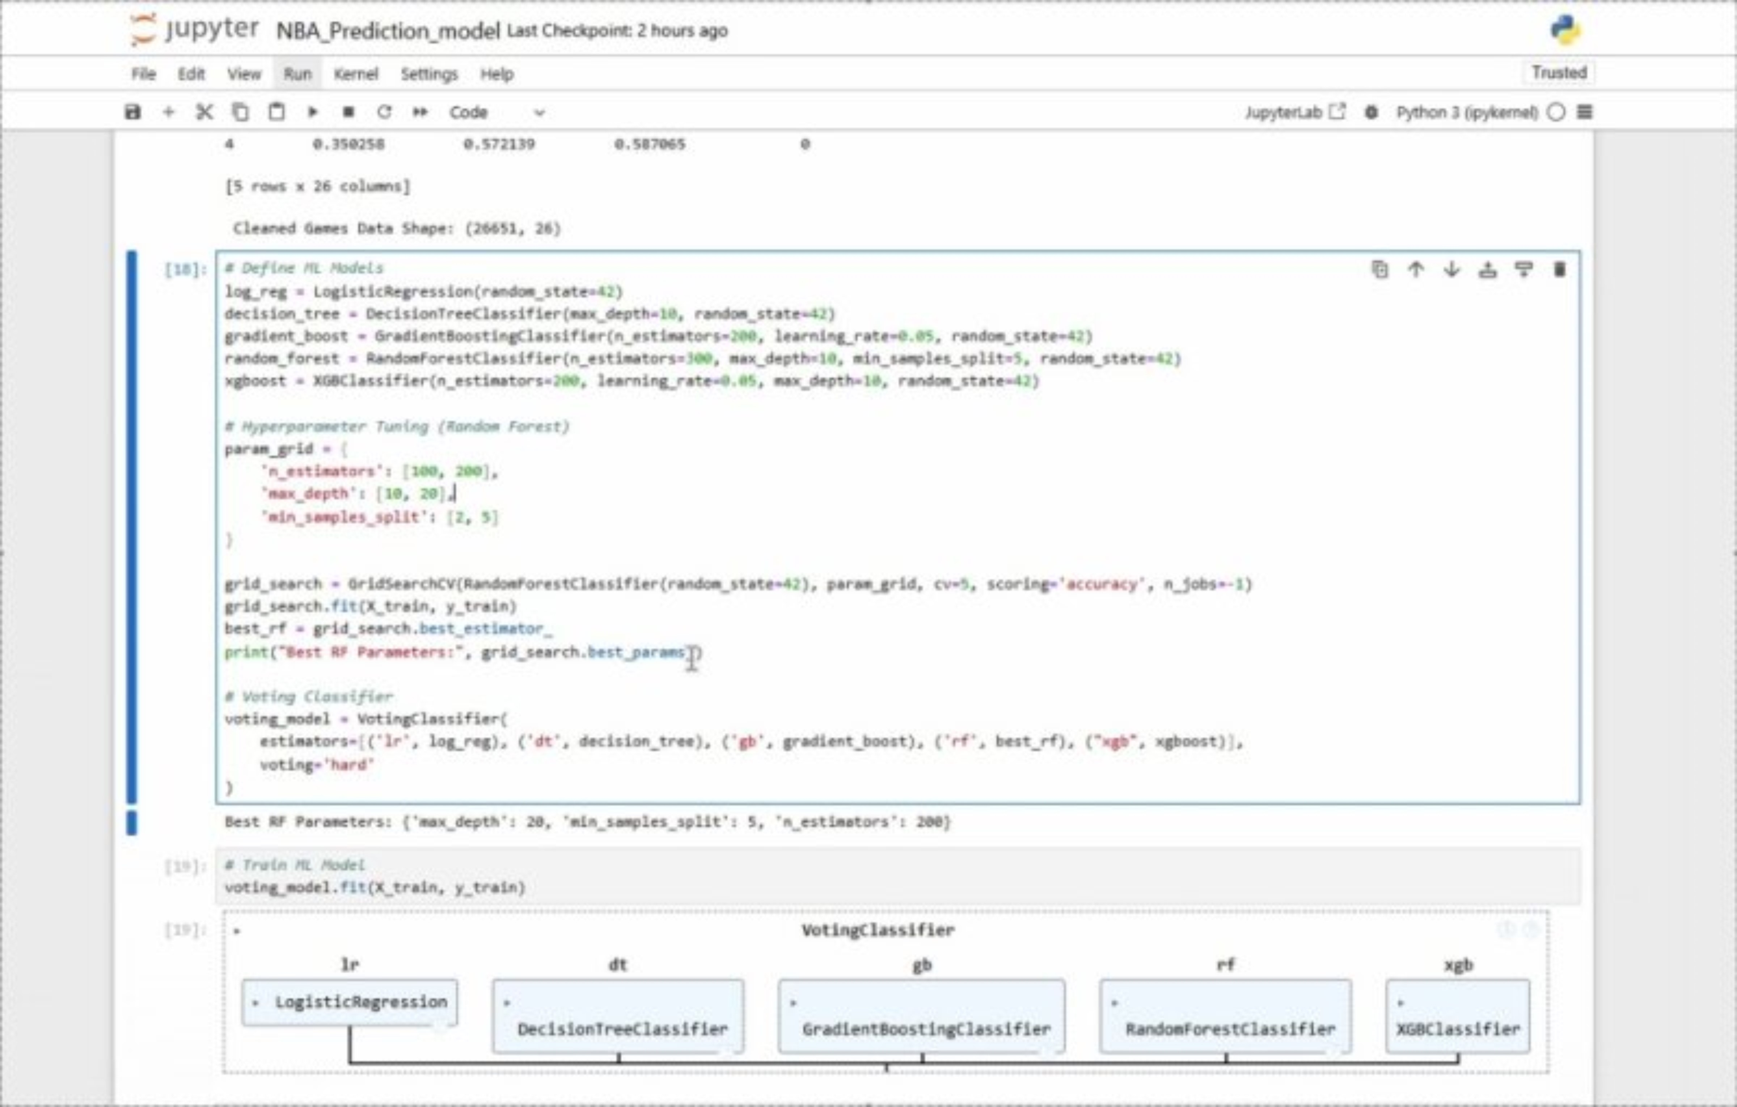
Demo !

